Slide 1

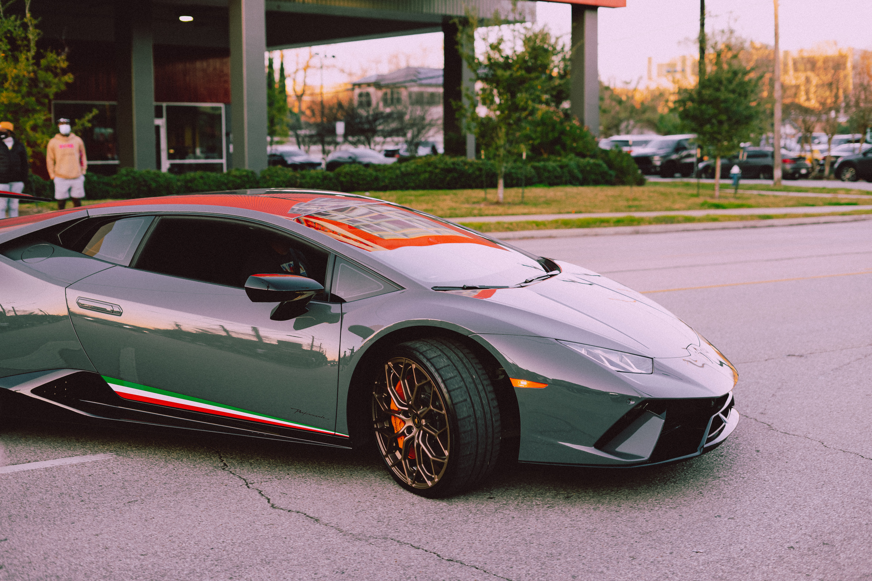
Car
Prize
Prediction
Doan Dang Khoa

Slide 2


Content
1
Data Overview
2
Visualize Dataset
3
Traning Model
4
Statement

Slide 3
1
Data Overview

Slide 4
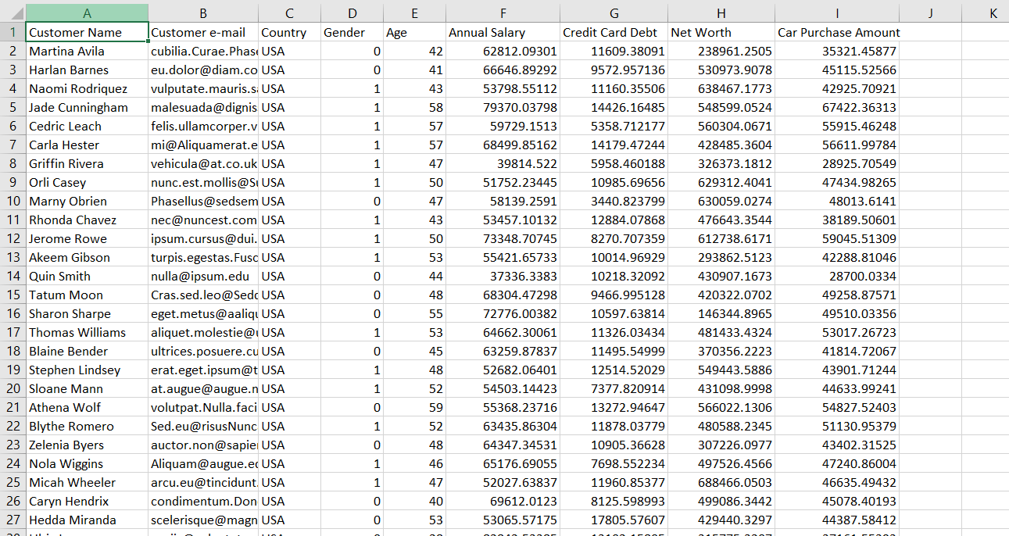
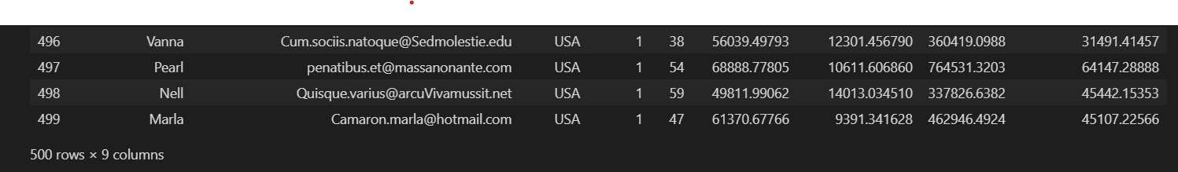
Customer Name
Customer email
Country
Gender
Age
Annual Salary
Credit Card Debt
Net Worth

Slide 5
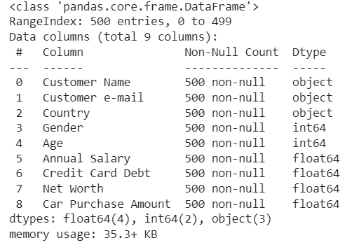
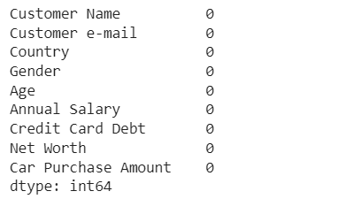
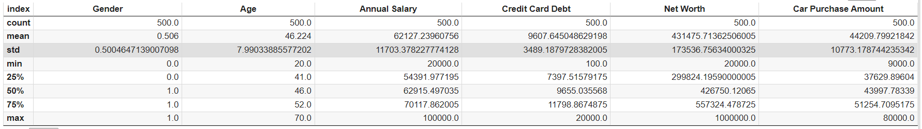

Slide 6
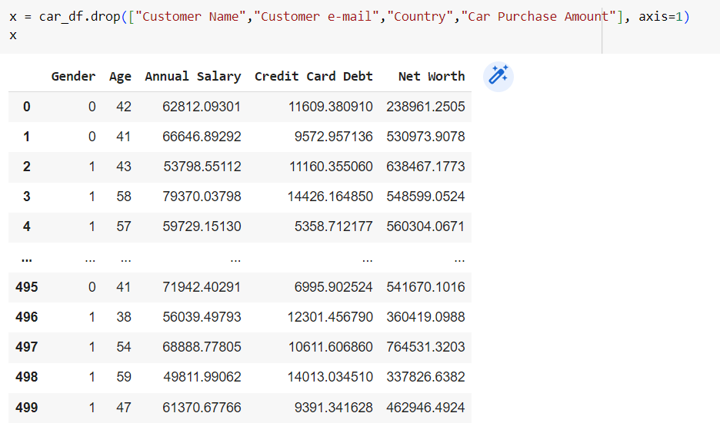
Drop Customer Name
Drop Customer email
Drop country
Drop Car Purchase Amount

Slide 7
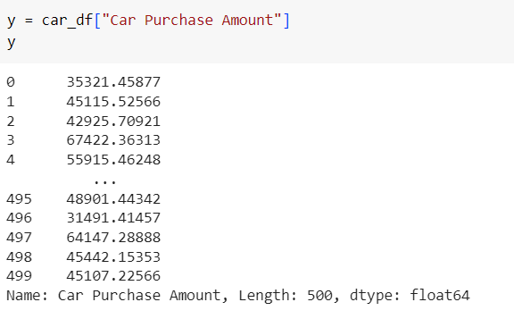
Set the value y doing the output value

Slide 8
2
Visualize Data

Slide 9
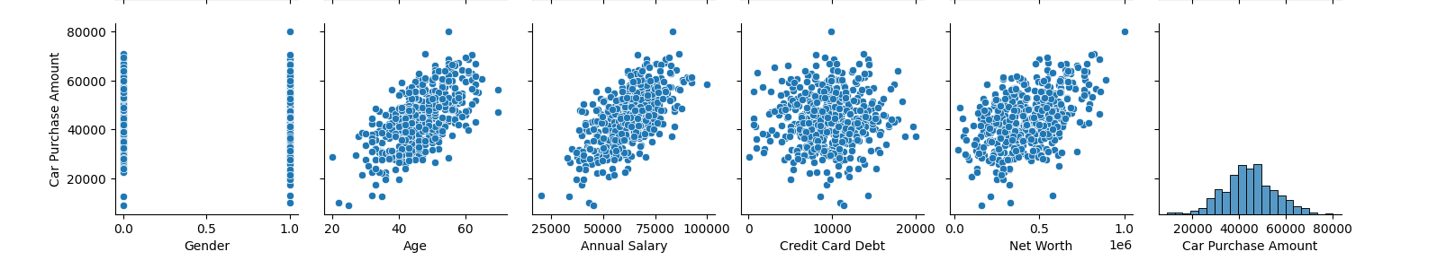
Car Purchase Amount is the thing that we must care about because that is our output to predict

Slide 10
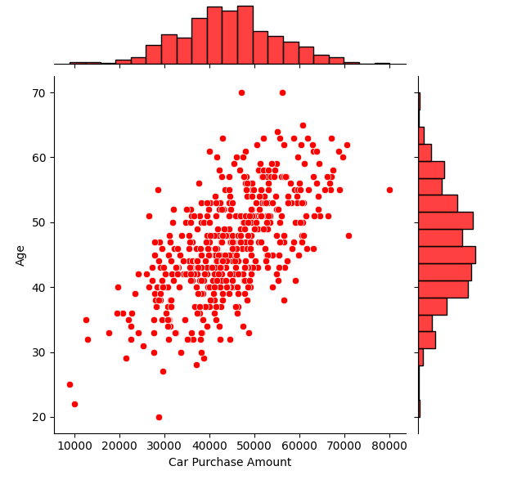

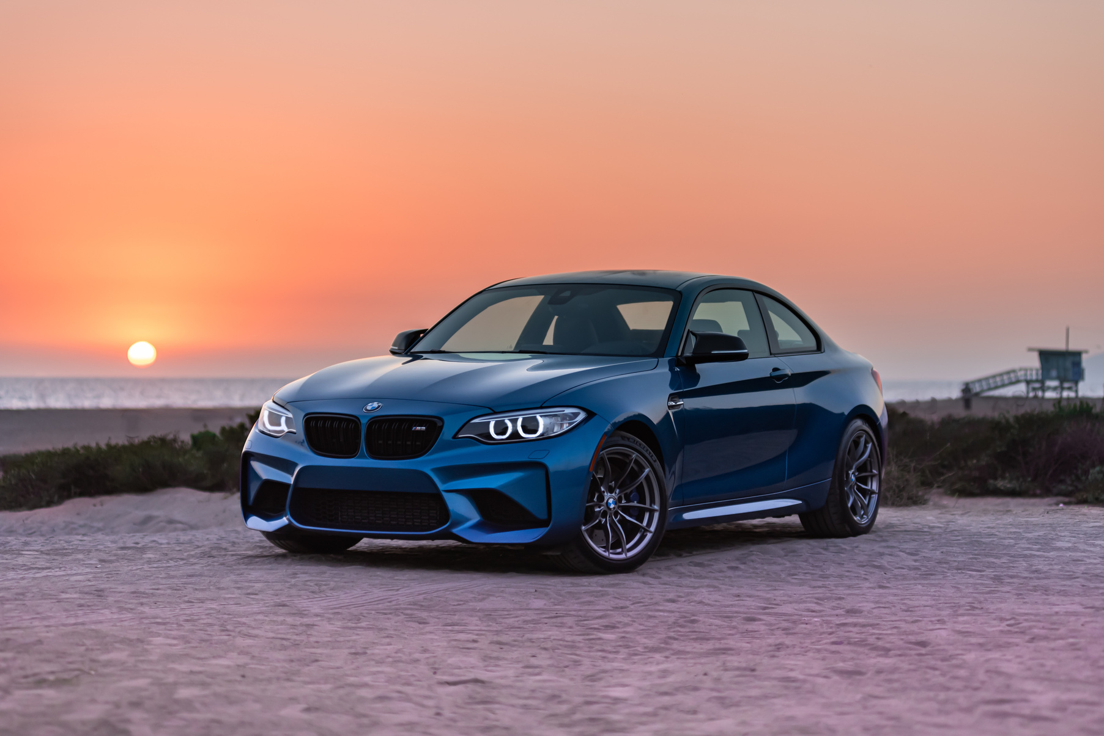
They become older so they can spent more money for their car
Most of the customers who buy cars fall and are between 30 and 50 years old

Slide 11
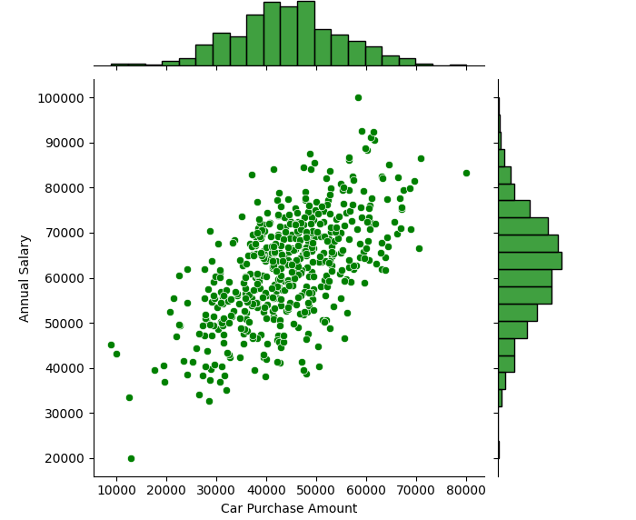
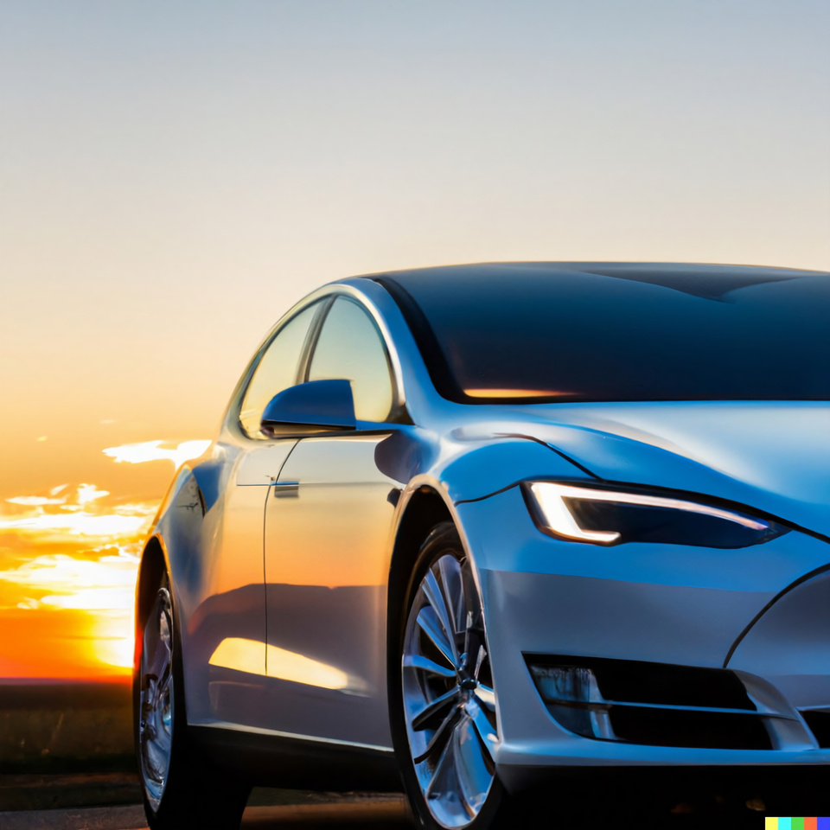

With completely proportional to age, the higher the annual salary, the more customers will accept to pay more to buy a car at a higher price.

Slide 12
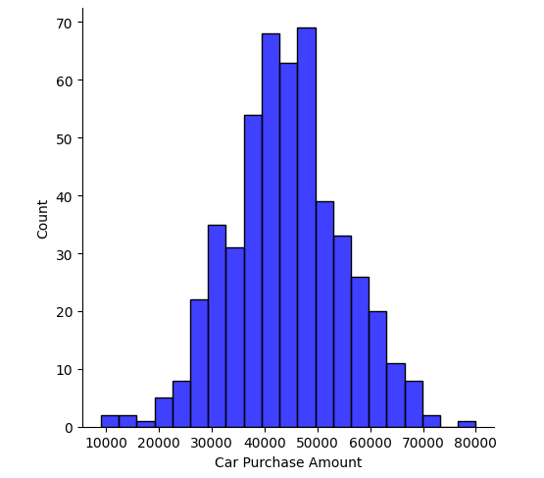

Currently, customers will focus on paying for vehicles with mid-range prices ranging from 40,000 to more than 50,000.

Slide 13
3
Training Model

Slide 14
80% => training
20% ➔=> test
The train_test_split() function returns four values: X_train, X_test, y_train, and y_test. X_train and y_train are the features and target variables used for training the model, while X_test and y_test are used for testing the performance of the model

Slide 15
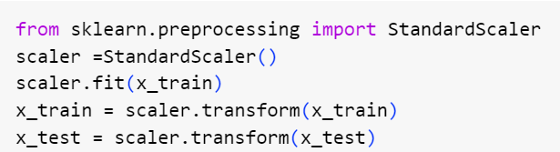
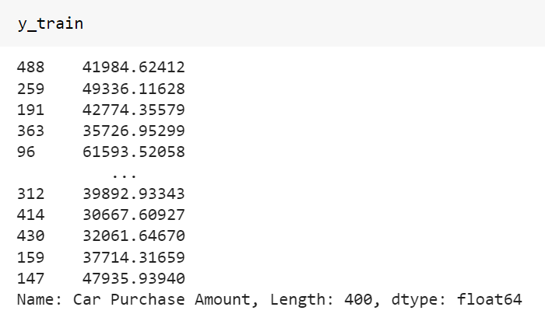
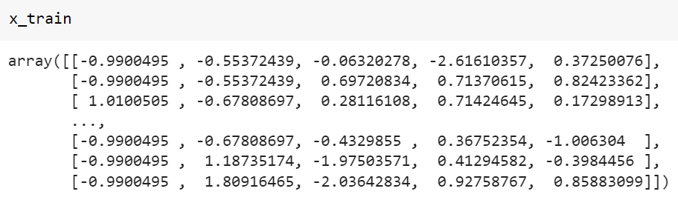
Scaling is the transformation of a range of data values ​​to a specific range such as 0-1. In some Machine Learning algorithms where the distance between data points is important, like DT or Linear Regression, data scaling is extremely important, because every small change in the data can lead to unpredictable results before.

Slide 16
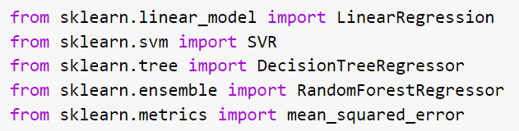
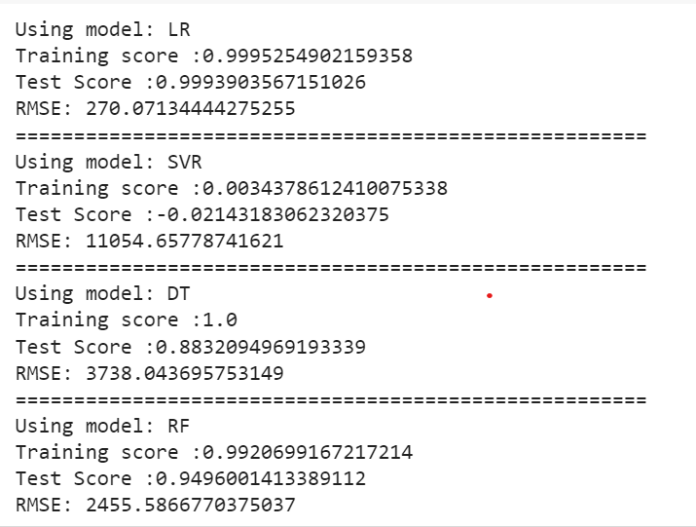

Slide 17
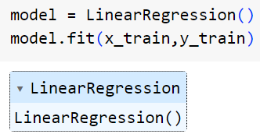
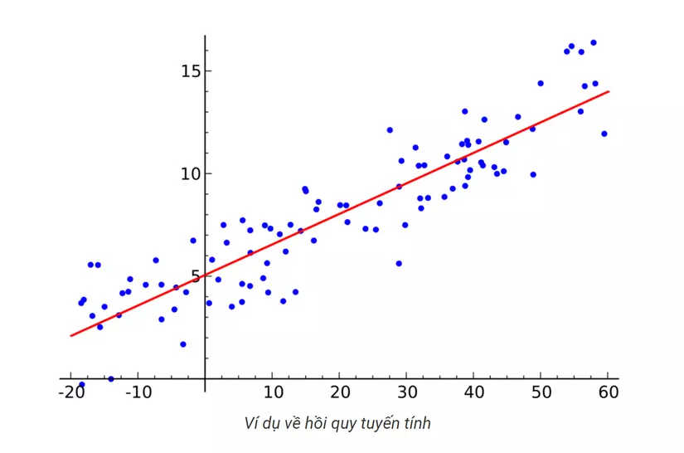
"Linear regression" is a method to predict the dependent variable (Y) based on the value of the independent variable (X). It can be used for cases where we want to predict a continuous quantity. For example, predicting traffic in a retail store,

Slide 18
4
Statement

Slide 19
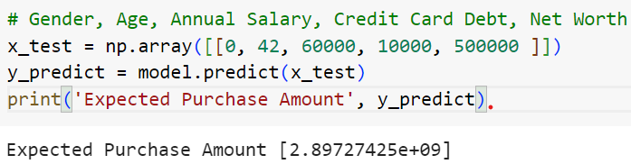
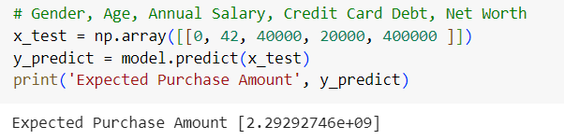
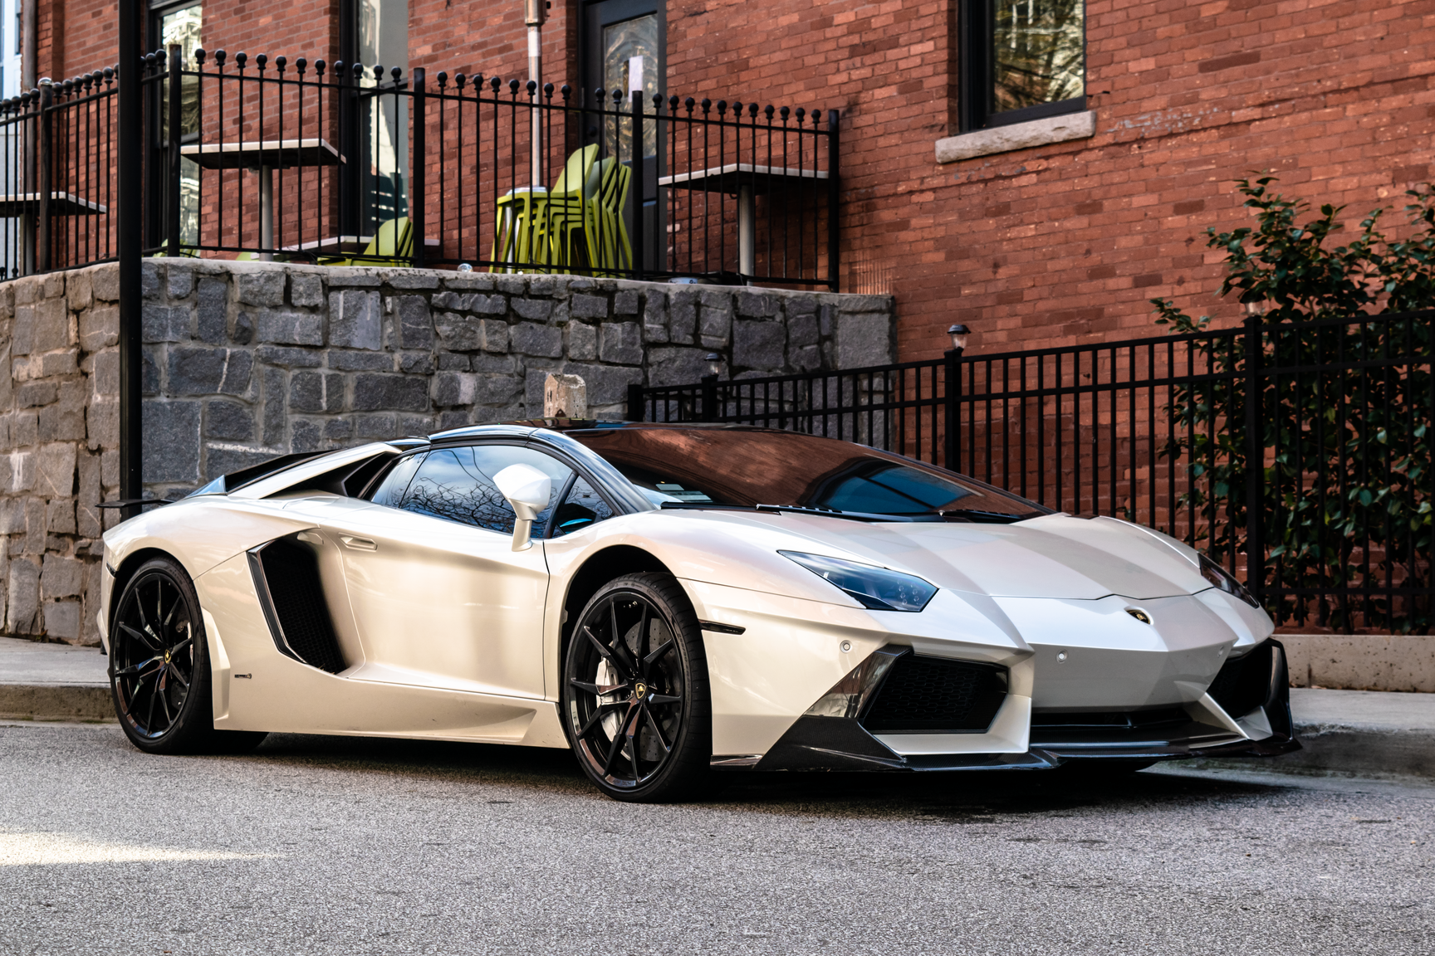
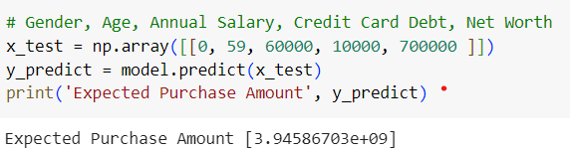
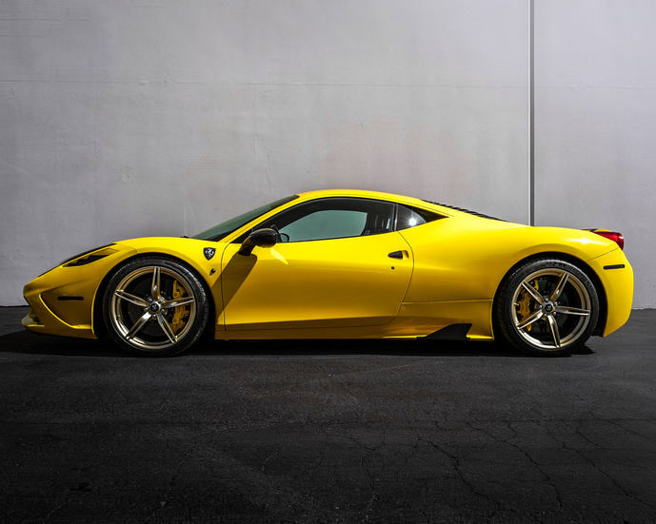

Slide 20
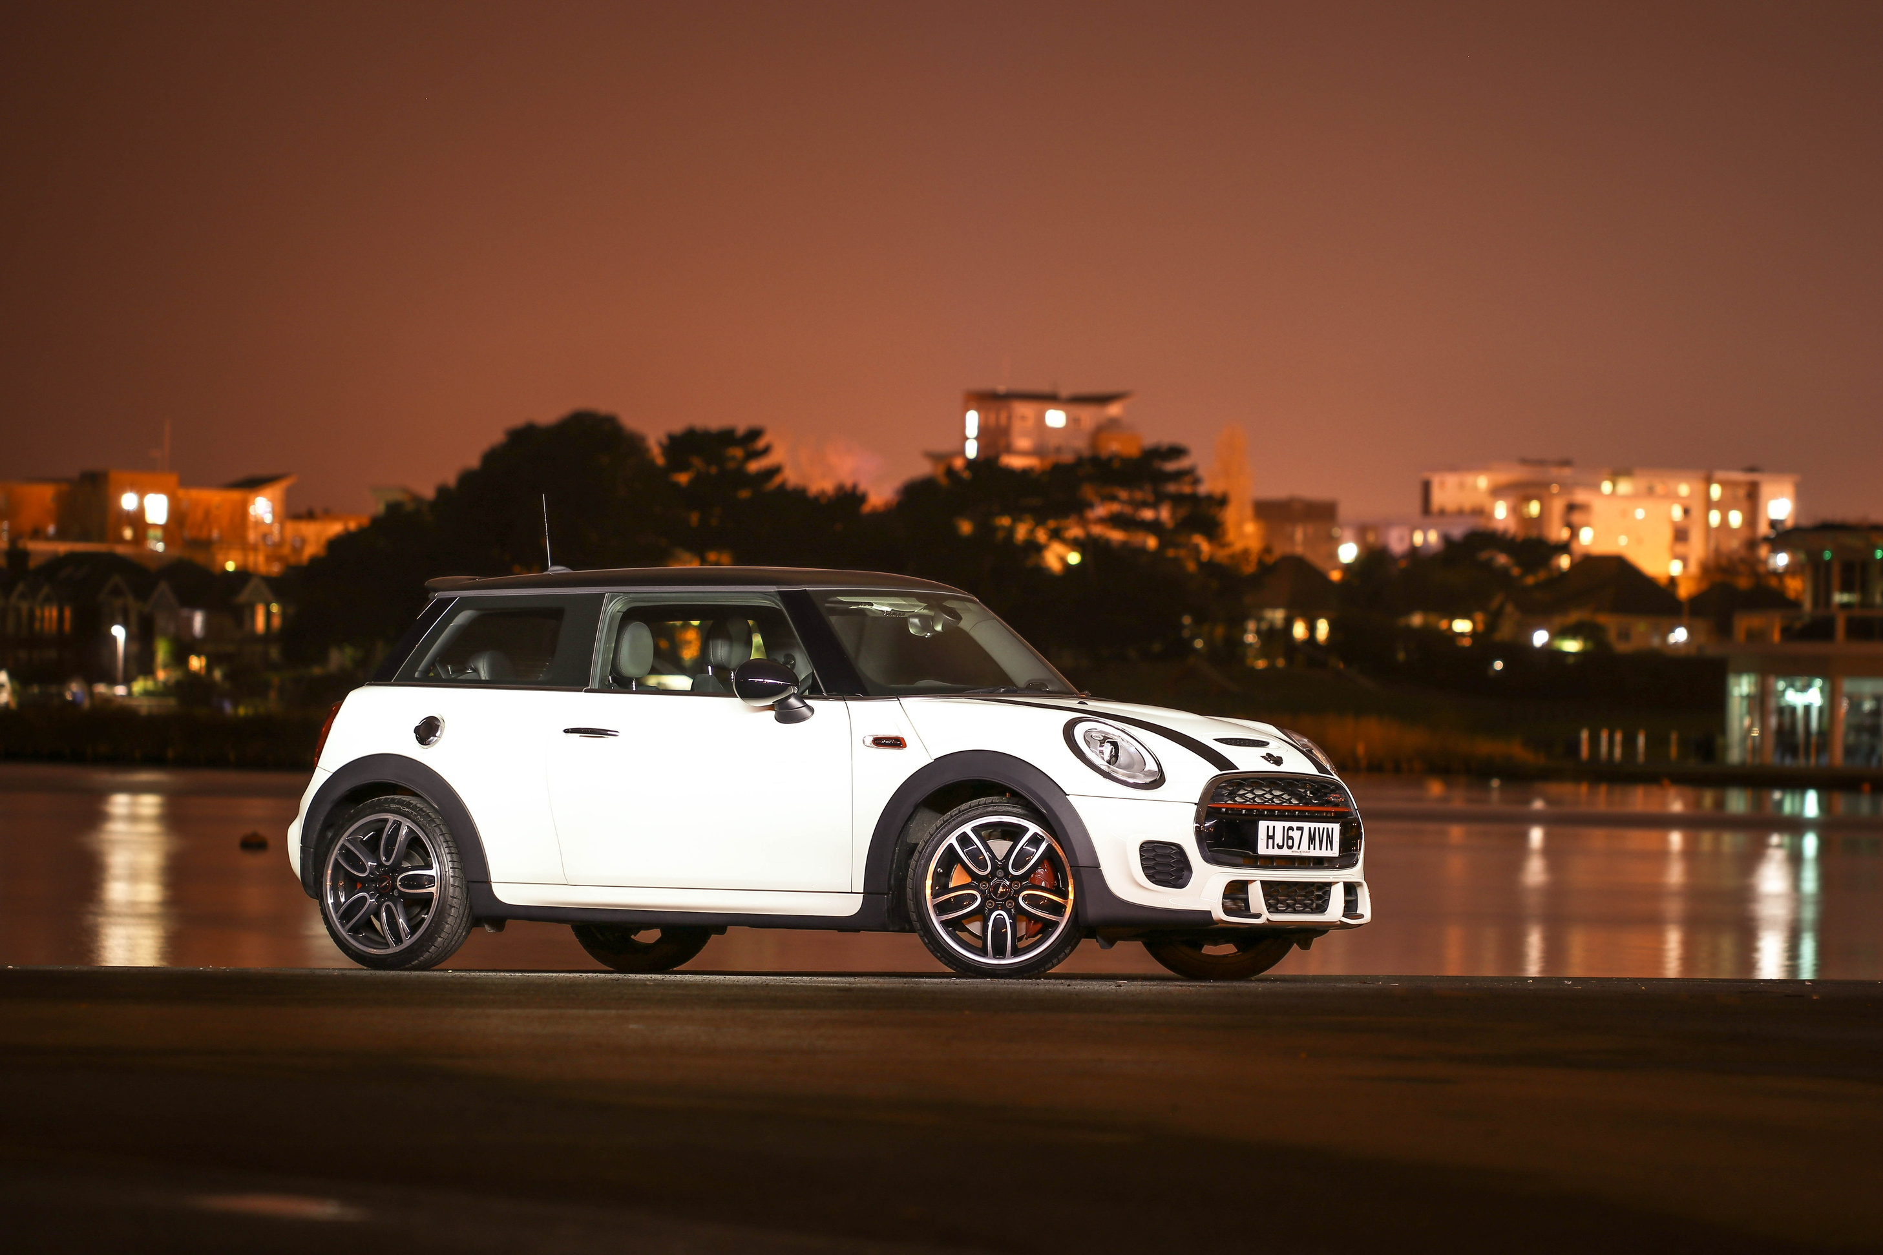
Thank you for listening
Phone
Email
0964249036
doandangkhoa1203@gmail.com

